Slide 1

Recycling Bottles!
“Recycle, Reward and Save the Planet"

Slide 2
Our Team :
Konrad Figarski
Ahmed Amodi
Islam Bourzah
Md Towhedur Rahman

Slide 3
Table of Contents
The Problem
Solution to the Problem
Objectives and Goals
Obstacles
Benefits
Conclusion
Any Question?
References

Slide 4
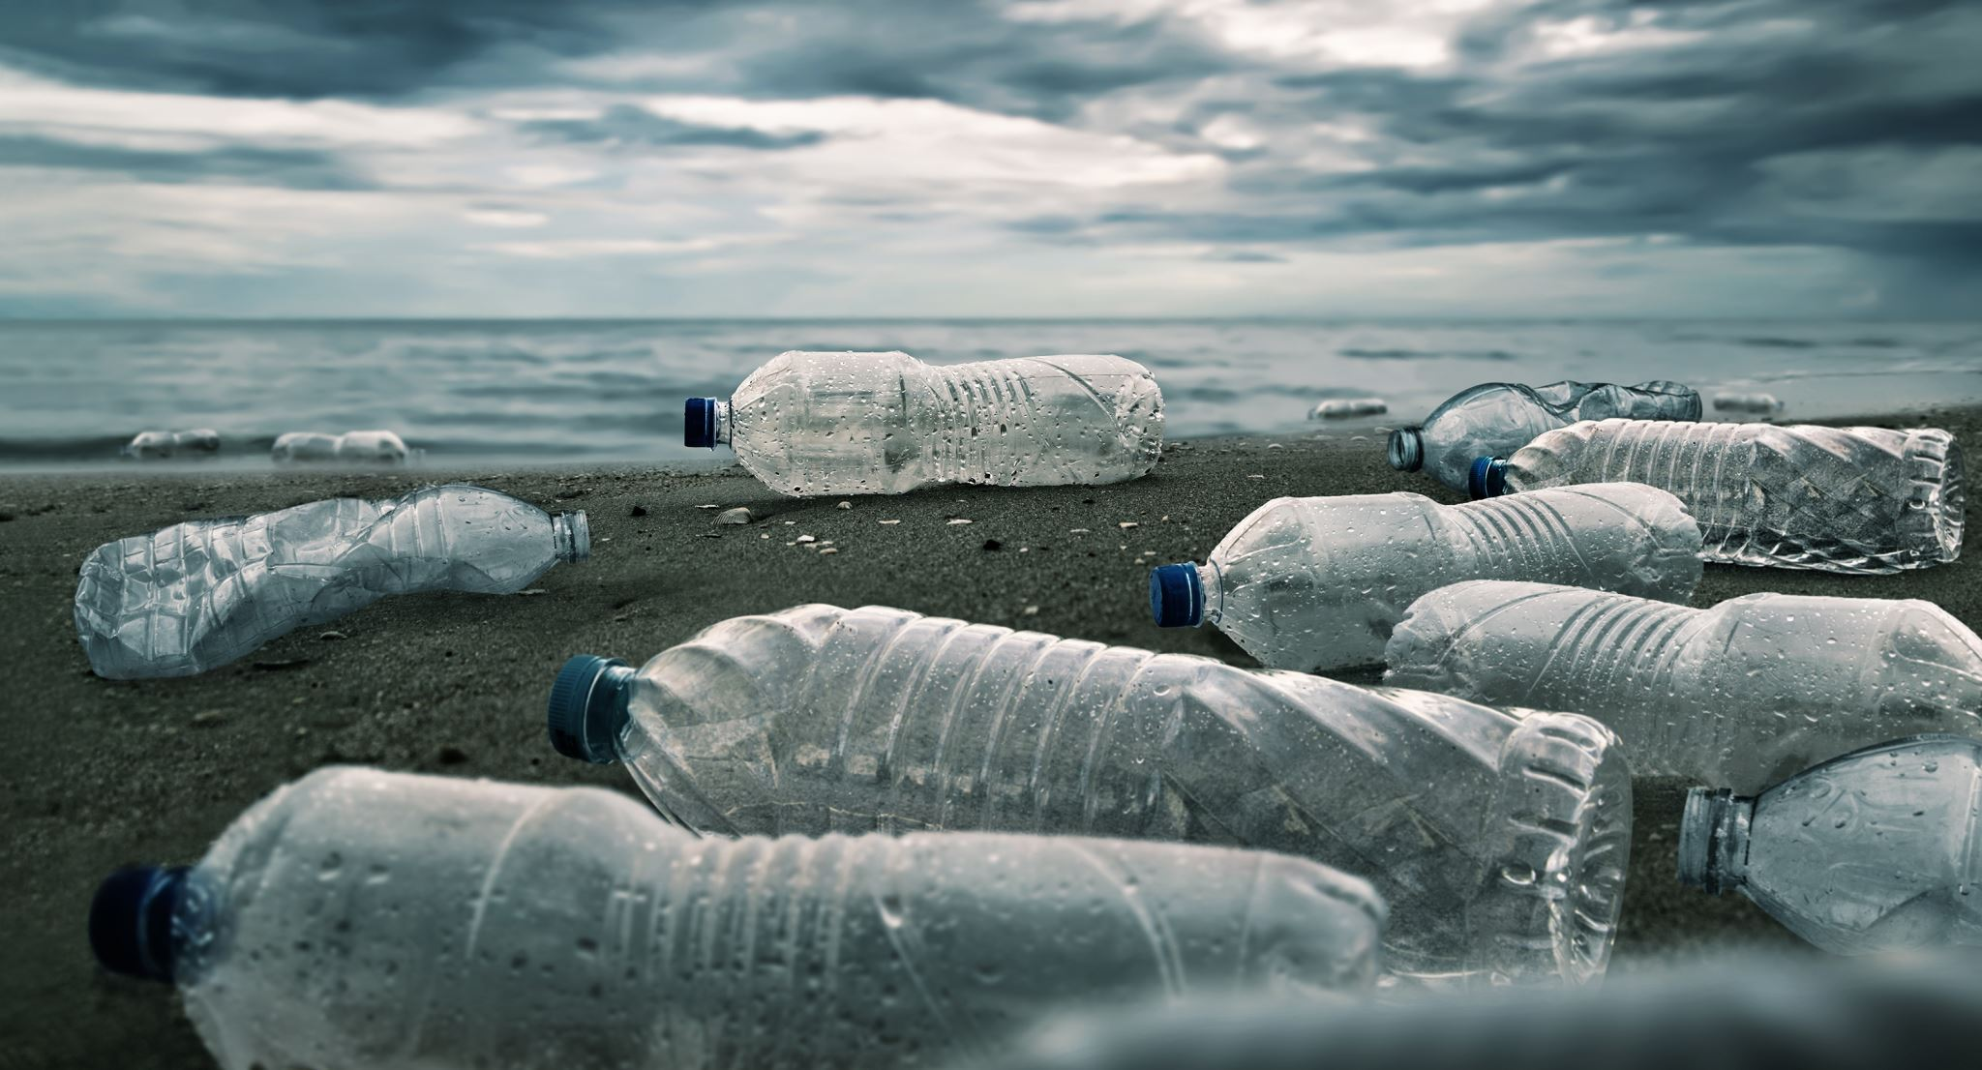
The Problem!
Plastic in today's day and age remains to be seen as one of the worst issues of environment.
The use of polymer daily lives and extended use of plastic waste destroying the planet.
Plastic became hazardous waste.

Slide 5
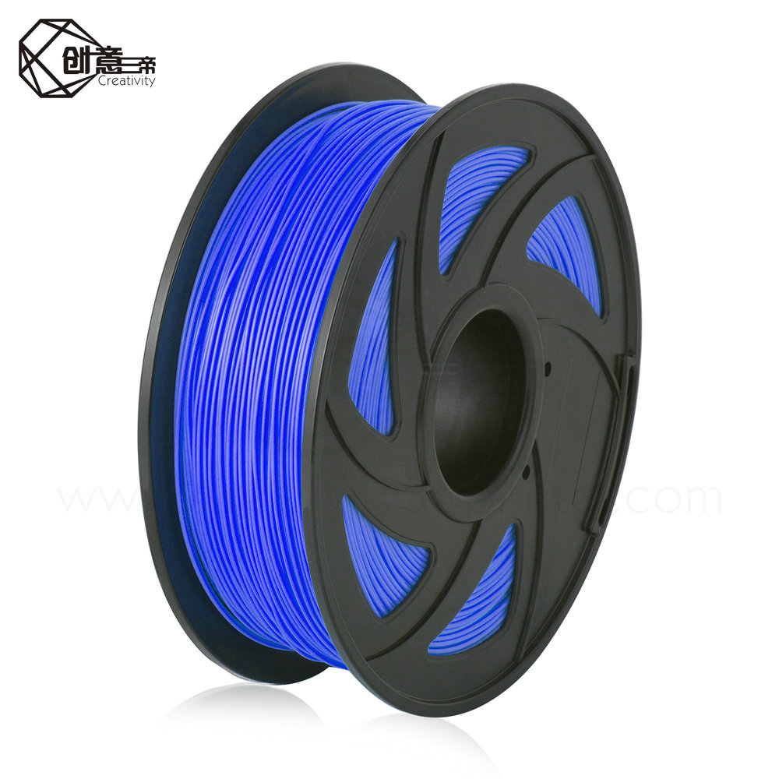
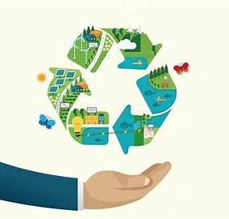

Solution!
Turn plastic waste into filament for use in 3D printing
Reduces overall waste and contributes to the global plastic recycling effort.
Incentivizes the recycling of plastic through a system of “Recycle and Reward”
The more they recycle, the more points they accumulate!
The filament can be sold online as an eco-friendly filament alternative.

Slide 6

Objectives and Goals
The goal of this project is to design, build, and test an extruder that converts PET bottles into 3D printing filament.
The focus is specifically on creating 3D printing filaments made from PET bottles.
The broader goal will be to Recover, Redesign and Remanufacture new products from plastic.

Slide 7

Obstacles
Equipment costs.
Some supermarkets are not spacious.
As an alternative arrangement using council collection points.
Advertising will be costly.

Slide 8
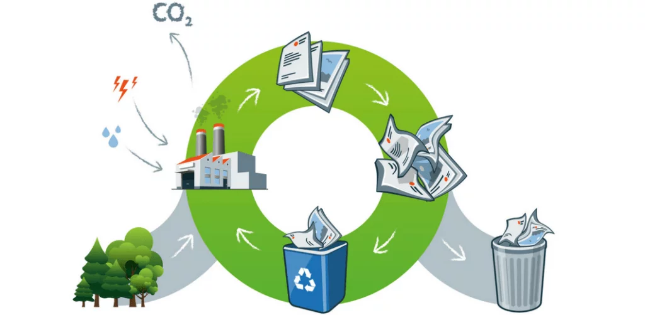
Benefits
Encourage people to recycle more plastic.
Reduces manufacturing waste, lowers the carbon footprint, and supports the economy.
3D printing will allow to investment in the future generation of technology.
Investing in the future generation too!

Slide 9
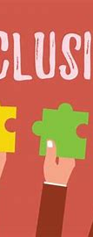
Conclusion
Our goal is to help reduce plastic waste by reusing plastics in an innovative way.
Incentivizing the recycling plastics and building a brighter future for the coming generations.

Slide 10

Any questions?
Question
Answer
Thank you for being with us!

Slide 11
References
Hannah Ritchie and Max Roser (2018) - "Plastic Pollution". Published online at OurWorldInData.org. Retrieved from: 'https://ourworldindata.org/plastic-pollution'
3D printing filament as a second life of waste plAnoastics—a review (nih.gov)
https://www.lexology.com/library/detail.aspx?g=84abb734-0bec-428c-9077-35aaeb73488f)
www.bpf.co.uk/Sustainability/pet_plastic_bottles_facts_not_myths.aspx
www.43dprint.org/recycling-3d-printer-filament/
www.livescience.com/how-much-plastic-recycling.html

